Slide 1



Introduction To Linux Kernel Development Session 3
Part 3: "Hello World" Kernel Module
Chaitanya Lala, Steven French, Mickaël Salaün, K Y Srinivasan

Slide 2
Instructors
Chaitanya Lala
Steven French
Mickaël Salaün
K Y Srinivasan

Slide 3
Session 3: “Hello World” Kernel Module Chaitanya Lala, Steven French, Mickaël Salaün, K Y Srinivasan
Topics Covered:
Building a kernel module
“In-tree” module building
“Out of” tree module building
The kbuild system – Module Makefile example
Loading a kernel module
Kernel symbol table
Analyzing a kernel oops
Lab:
~/class-projects/week3
Compile the kernel module
Load/unload the module
Force a kernel oops

Slide 4
What are Kernel Modules?
Linux Kernel has a pluggable binary architecture
Everything does not need to compiled into a single binary image
Some components can be loaded at runtime and thus can be compiled as standalone binaries --> modules
Are pieces of code that can be loaded and unloaded into the kernel upon demand.
Extend the functionality of the kernel without the need to reboot the system.
Like dynamic loaded/linked libraires in user-space programs
Have access to entire kernel memory and runs at kernel privilege levels (Be careful – this is kernel code!)
Most components which are not kernel core/proper are usually compiled in as modules – example device drivers, netfilter components, virtualization extensions etc.

Slide 5
Types of Modules
Out-of-Tree Modules
In-Kernel Tree Modules.

Slide 6
Out-of-Tree Modules
Built against a targeted set of kernel versions/headers.
Not part of the kernel KConfig and Makefiles.
Cannot be enabled via the Kernel build system.
Frequently used by device driver vendors to implement proprietary licensed binary blobs.
Need to be constantly impedance matched against new kernel versions because they are not part of the regular kernel maintenance procedure
Notes:
clala@mariner-image [ ~/develop/kernel/hello-1 ]$ cat Makefile
obj-m += hello-1.o
PWD := $(CURDIR)
all:
make -C /lib/modules/$(shell uname -r)/build M=$(PWD) modules
clean:
make -C /lib/modules/$(shell uname -r)/build M=$(PWD) clean
clala@mariner-image [ ~/develop/kernel/hello-1 ]$ cat hello-1.c
/*
* hello-1.c - The simplest kernel module.
*/
#include <linux/kernel.h> /* Needed for pr_info() */
#include <linux/module.h> /* Needed by all modules */
int init_module(void)
{
pr_info("Hello world 1.\n");
/* A non 0 return means init_module failed; module can't be loaded. */
return 0;
}
void cleanup_module(void)
{
pr_info("Goodbye world 1.\n");
}
MODULE_LICENSE("GPL");
clala@mariner-image [ ~/develop/kernel/hello-1 ]$

Slide 7
In-Kernel Tree Modules
Allow the module to be configured from the Kernel MenuConfig system.
Should not be different from code perspective.
Permits the code to be maintained with new Kernel releases
Notes:
From 05f4a66a20542cd71e84c8921190ebf522778d59 Mon Sep 17 00:00:00 2001
From: Chaitanya Lala <chlala@microsoft.com>
Date: Tue, 29 Mar 2022 01:06:21 +0000
Subject: [PATCH 1/1] Add a Hello World Module
Create an in-tree dummy module.
Signed-off-by: Chaitanya Lala <chlala@microsoft.com>
---
drivers/misc/Kconfig | 1 +
drivers/misc/Makefile | 1 +
drivers/misc/hello/Kconfig | 8 ++++++++
drivers/misc/hello/Makefile | 2 ++
drivers/misc/hello/hello.c | 21 +++++++++++++++++++++
5 files changed, 33 insertions(+)
create mode 100644 drivers/misc/hello/Kconfig
create mode 100644 drivers/misc/hello/Makefile
create mode 100644 drivers/misc/hello/hello.c
diff --git a/drivers/misc/Kconfig b/drivers/misc/Kconfig
index 0f5a49fc7c9e..0bcb5be79223 100644
--- a/drivers/misc/Kconfig
+++ b/drivers/misc/Kconfig
@@ -480,6 +480,7 @@ source "drivers/misc/mei/Kconfig"
source "drivers/misc/vmw_vmci/Kconfig"
source "drivers/misc/genwqe/Kconfig"
source "drivers/misc/echo/Kconfig"
+source "drivers/misc/hello/Kconfig"
source "drivers/misc/cxl/Kconfig"
source "drivers/misc/ocxl/Kconfig"
source "drivers/misc/bcm-vk/Kconfig"
diff --git a/drivers/misc/Makefile b/drivers/misc/Makefile
index a086197af544..89f484d5b411 100644
--- a/drivers/misc/Makefile
+++ b/drivers/misc/Makefile
@@ -47,6 +47,7 @@ obj-$(CONFIG_SRAM) += sram.o
obj-$(CONFIG_SRAM_EXEC) += sram-exec.o
obj-$(CONFIG_GENWQE) += genwqe/
obj-$(CONFIG_ECHO) += echo/
+obj-$(CONFIG_HELLO) += hello/
obj-$(CONFIG_CXL_BASE) += cxl/
obj-$(CONFIG_DW_XDATA_PCIE) += dw-xdata-pcie.o
obj-$(CONFIG_PCI_ENDPOINT_TEST) += pci_endpoint_test.o
diff --git a/drivers/misc/hello/Kconfig b/drivers/misc/hello/Kconfig
new file mode 100644
index 000000000000..d5833b1b27bf
--- /dev/null
+++ b/drivers/misc/hello/Kconfig
@@ -0,0 +1,8 @@
+# SPDX-License-Identifier: GPL-2.0-only
+config HELLO
+ tristate "Do-Nothing Hello-World Module"
+ help
+ This module does nothing apart from saying hello.
+
+ To compile this driver as a module, choose M here. The module
+ will be called echo.
diff --git a/drivers/misc/hello/Makefile b/drivers/misc/hello/Makefile
new file mode 100644
index 000000000000..82705eeeade4
--- /dev/null
+++ b/drivers/misc/hello/Makefile
@@ -0,0 +1,2 @@
+# SPDX-License-Identifier: GPL-2.0-only
+obj-$(CONFIG_HELLO) += hello.o
diff --git a/drivers/misc/hello/hello.c b/drivers/misc/hello/hello.c
new file mode 100644
index 000000000000..cc225780c096
--- /dev/null
+++ b/drivers/misc/hello/hello.c
@@ -0,0 +1,21 @@
+/*
+ * hello.c - The simplest kernel module.
+ */
+#include <linux/kernel.h> /* Needed for pr_info() */
+#include <linux/module.h> /* Needed by all modules */
+
+int init_module(void)
+{
+ pr_info("Hello world 1.\n");
+
+ /* A non 0 return means init_module failed; module can't be loaded. */
+ return 0;
+}
+
+void cleanup_module(void)
+{
+ pr_info("Goodbye world 1.\n");
+}
+
+MODULE_LICENSE("GPL");
+
--
2.33.0

Slide 8
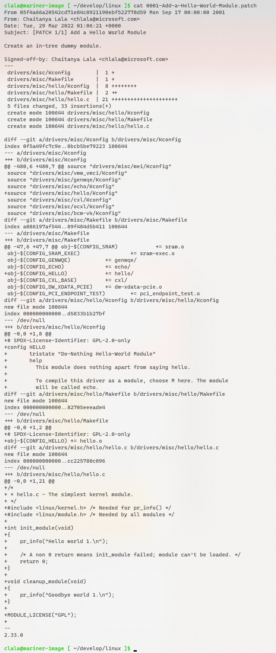
In-Kernel Tree Modules - Example
Notes:
From 05f4a66a20542cd71e84c8921190ebf522778d59 Mon Sep 17 00:00:00 2001
From: Chaitanya Lala <chlala@microsoft.com>
Date: Tue, 29 Mar 2022 01:06:21 +0000
Subject: [PATCH 1/1] Add a Hello World Module
Create an in-tree dummy module.
Signed-off-by: Chaitanya Lala <chlala@microsoft.com>
---
drivers/misc/Kconfig | 1 +
drivers/misc/Makefile | 1 +
drivers/misc/hello/Kconfig | 8 ++++++++
drivers/misc/hello/Makefile | 2 ++
drivers/misc/hello/hello.c | 21 +++++++++++++++++++++
5 files changed, 33 insertions(+)
create mode 100644 drivers/misc/hello/Kconfig
create mode 100644 drivers/misc/hello/Makefile
create mode 100644 drivers/misc/hello/hello.c
diff --git a/drivers/misc/Kconfig b/drivers/misc/Kconfig
index 0f5a49fc7c9e..0bcb5be79223 100644
--- a/drivers/misc/Kconfig
+++ b/drivers/misc/Kconfig
@@ -480,6 +480,7 @@ source "drivers/misc/mei/Kconfig"
source "drivers/misc/vmw_vmci/Kconfig"
source "drivers/misc/genwqe/Kconfig"
source "drivers/misc/echo/Kconfig"
+source "drivers/misc/hello/Kconfig"
source "drivers/misc/cxl/Kconfig"
source "drivers/misc/ocxl/Kconfig"
source "drivers/misc/bcm-vk/Kconfig"
diff --git a/drivers/misc/Makefile b/drivers/misc/Makefile
index a086197af544..89f484d5b411 100644
--- a/drivers/misc/Makefile
+++ b/drivers/misc/Makefile
@@ -47,6 +47,7 @@ obj-$(CONFIG_SRAM) += sram.o
obj-$(CONFIG_SRAM_EXEC) += sram-exec.o
obj-$(CONFIG_GENWQE) += genwqe/
obj-$(CONFIG_ECHO) += echo/
+obj-$(CONFIG_HELLO) += hello/
obj-$(CONFIG_CXL_BASE) += cxl/
obj-$(CONFIG_DW_XDATA_PCIE) += dw-xdata-pcie.o
obj-$(CONFIG_PCI_ENDPOINT_TEST) += pci_endpoint_test.o
diff --git a/drivers/misc/hello/Kconfig b/drivers/misc/hello/Kconfig
new file mode 100644
index 000000000000..d5833b1b27bf
--- /dev/null
+++ b/drivers/misc/hello/Kconfig
@@ -0,0 +1,8 @@
+# SPDX-License-Identifier: GPL-2.0-only
+config HELLO
+ tristate "Do-Nothing Hello-World Module"
+ help
+ This module does nothing apart from saying hello.
+
+ To compile this driver as a module, choose M here. The module
+ will be called echo.
diff --git a/drivers/misc/hello/Makefile b/drivers/misc/hello/Makefile
new file mode 100644
index 000000000000..82705eeeade4
--- /dev/null
+++ b/drivers/misc/hello/Makefile
@@ -0,0 +1,2 @@
+# SPDX-License-Identifier: GPL-2.0-only
+obj-$(CONFIG_HELLO) += hello.o
diff --git a/drivers/misc/hello/hello.c b/drivers/misc/hello/hello.c
new file mode 100644
index 000000000000..cc225780c096
--- /dev/null
+++ b/drivers/misc/hello/hello.c
@@ -0,0 +1,21 @@
+/*
+ * hello.c - The simplest kernel module.
+ */
+#include <linux/kernel.h> /* Needed for pr_info() */
+#include <linux/module.h> /* Needed by all modules */
+
+int init_module(void)
+{
+ pr_info("Hello world 1.\n");
+
+ /* A non 0 return means init_module failed; module can't be loaded. */
+ return 0;
+}
+
+void cleanup_module(void)
+{
+ pr_info("Goodbye world 1.\n");
+}
+
+MODULE_LICENSE("GPL");
+
--
2.33.0

Slide 9
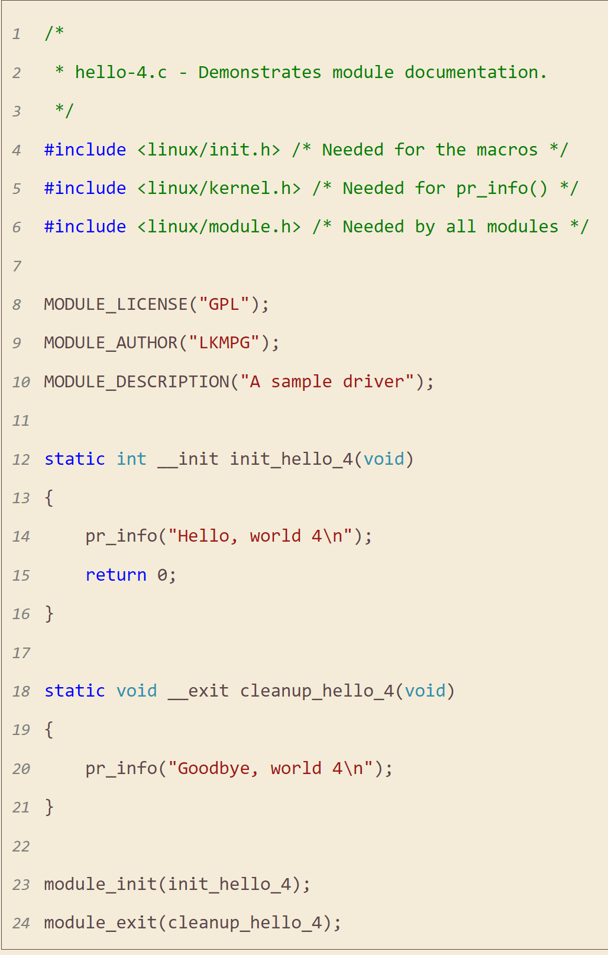

Anatomy of a Kernel Module
// Must be correct code license
// Author's name
// Entry Function Registration
// Exit Function Registration

Slide 10
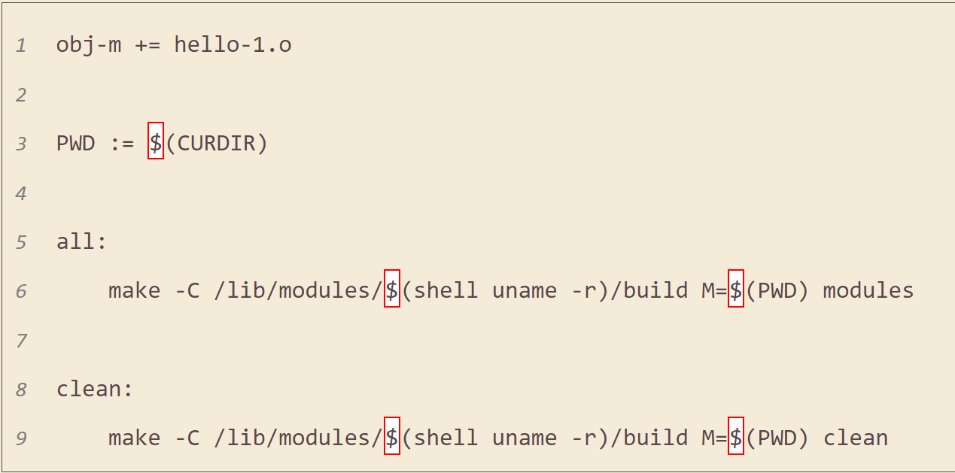
MakeFile – Out Of Tree (Running Kernel)

Slide 11
How to load/unload a Kernel Module?
insmod <mod-name>.ko
OR
modprobe <mod-name>
Finds dependencies and loads in order
rmmod<mod-name>
OR
modprobe -r <mod-name>
Finds dependencies and unloads in order

Slide 12
Kernel Symbol Table
Table of symbol address to symbol name (and other information)
For built-in symbols or ones compiled with the Kernel image, a file is generated called System.map.
For run-time view which includes loaded modules and where those symbols exist in memory - /proc/kallsyms
https://man7.org/linux/man-pages/man1/nm.1.html

Slide 13
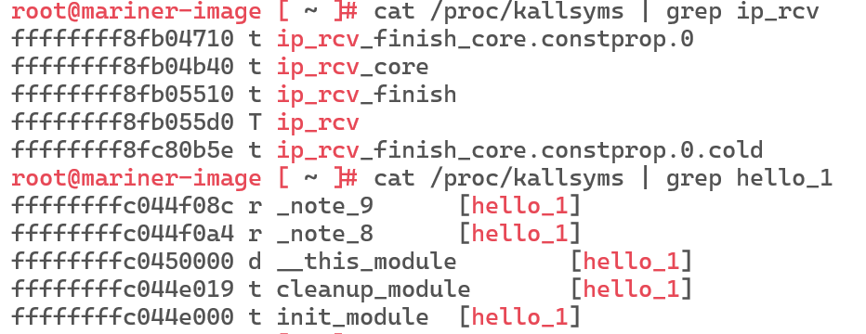
Kernel Symbol Table - kallsyms

Slide 14
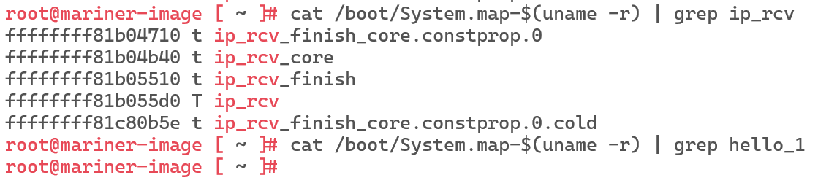
Kernel Symbol Table - System.map

Slide 15
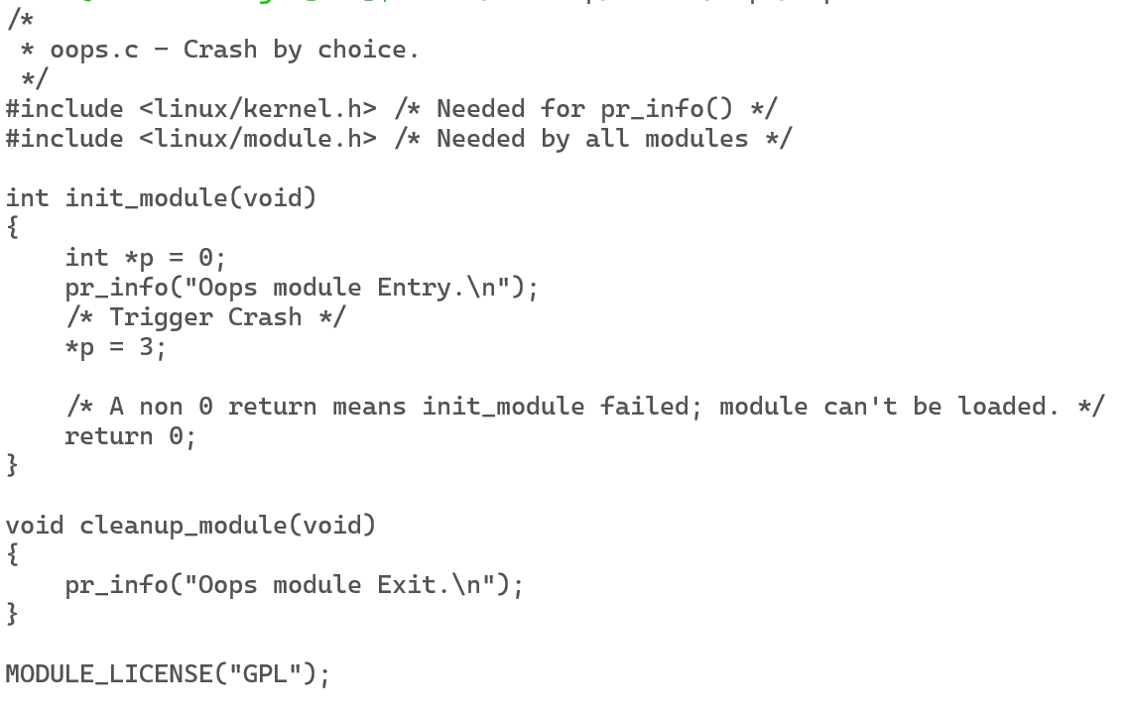
Kernel Module OOPS

Slide 16
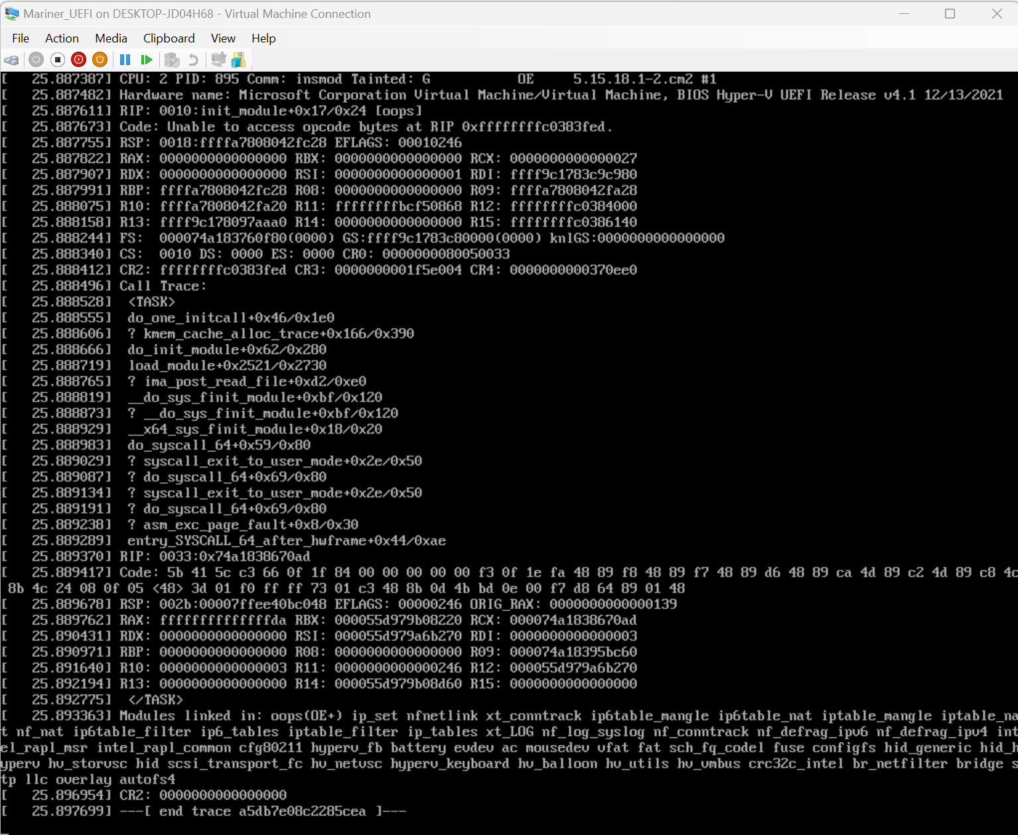
How to make sense of a Kernel OOPS?
Notes:
https://wiki.osdev.org/Calling_Conventions
http://embeddedguruji.blogspot.com/2018/12/analyzing-oops-message-of-linux-kernel.html
https://www.linuxjournal.com/content/oops-debugging-kernel-panics-0
https://www.opensourceforu.com/2011/01/understanding-a-kernel-oops/
https://www.kernel.org/doc/html/latest/admin-guide/bug-hunting.html

Slide 17
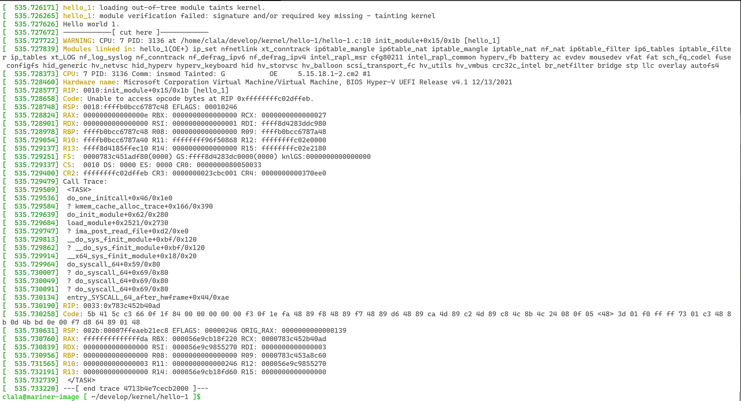
Shows the CPU was executing code and what process ID was on that CPU when the code instruction at highlighted path and function/offset was hit.

Slide 18


Modules which were loaded when the exception condition hit

Slide 19
Comm: Name of the process which was executing in the kernel when the error hit. Might not always be make sense. Look at the stack to see if it is relevant or not.
Tainted kernels — The Linux Kernel documentation

Slide 20
Address = CS:RIP. Actual Error Message is defined here

Slide 21




x86_64 register dump in kernel mode. See calling conventions to make sense of what register holds what value. System V ABI - OSDev Wiki.

Slide 22




x86_64 register dump in kernel mode. See calling conventions to make sense of what register holds what value. System V ABI - OSDev Wiki.

Slide 23





Stack Frame when the exception occurred. Symbol-Name + Offset shows the actual instruction in code where the CPU hit. To make sense of it use, objdump and gdb (disassemble <symbol-name>). Not that entry point into kernel a syscall invoked by insmod

Slide 24




Registers when process was running in user-space.

Slide 25
References
https://www.kernel.org/doc/Documentation/kbuild/modules.txt
https://www.kernel.org/doc/Documentation/kbuild/makefiles.txt
https://sysprog21.github.io/lkmpg/#what-is-a-kernel-module
https://wiki.osdev.org/Calling_Conventions
https://www.linuxjournal.com/content/oops-debugging-kernel-panics-0
https://www.opensourceforu.com/2011/01/understanding-a-kernel-oops/
https://www.kernel.org/doc/html/latest/admin-guide/bug-hunting.html
System V ABI - OSDev Wiki.
http://embeddedguruji.blogspot.com/2018/12/analyzing-oops-message-of-linux-kernel.html

